Slide 1
REGISTER TRANSFER AND MICROOPERATIONS
• Register Transfer Language
• Register Transfer
• Bus and Memory Transfers
• Arithmetic Microoperations
• Logic Microoperations
• Shift Microoperations
• Arithmetic Logic Shift Unit

Slide 2
SIMPLE DIGITAL SYSTEMS
Combinational and sequential circuits can be used to create simple digital systems.
These are the low-level building blocks of a digital computer.
Simple digital systems are frequently characterized in terms of
the registers they contain, and
the operations that they perform.
Typically,
What operations are performed on the data in the registers
What information is passed between registers

Slide 3
Digital computer
The internal hardware organization of a digital computer is best defined by specifying
The set of registers it contains and their functions
The sequence of microoperations performed on the binary information stored
The control that initiates the sequence of microoperations

Slide 4
MICROOPERATIONS (1)
Register Transfer Language
The operations on the data in registers are called microoperations.
The functions built into registers are examples of microoperations
Shift
Load
Clear
Increment
…

Slide 5
ORGANIZATION OF A DIGITAL SYSTEM
Register Transfer Language
Definition of the (internal) organization of a computer
- Set of registers and their functions
- Microoperations set
Set of allowable microoperations provided
by the organization of the computer
- Control signals that initiate the sequence of
microoperations (to perform the functions)

Slide 6
REGISTER TRANSFER LEVEL
Register Transfer Language
Viewing a computer, or any digital system, in this way is called the register transfer level
This is because we’re focusing on
The system’s registers
The data transformations in them, and
The data transfers between them.

Slide 7
REGISTER TRANSFER LANGUAGE
Register Transfer Language
Rather than specifying a digital system in words, a specific notation is used, register transfer language
For any function of the computer, the register transfer language can be used to describe the (sequence of) microoperations
Register transfer language
A symbolic language
A convenient tool for describing the internal organization of digital computers
Can also be used to facilitate the design process of digital systems.

Slide 8
DESIGNATION OF REGISTERS
Register Transfer Language
Registers are designated by capital letters, sometimes followed by numbers (e.g., A, R13, IR)
Often the names indicate function:
MAR - memory address register
PC - program counter
IR - instruction register
Registers and their contents can be viewed and represented in various ways
A register can be viewed as a single entity:
Registers may also be represented showing the bits of data they contain
MAR

Slide 9
DESIGNATION OF REGISTERS
Register Transfer Language
Designation of a register
- a register
- portion of a register
- a bit of a register
Common ways of drawing the block diagram of a register
Register
Showing individual bits
R1
7 6 5 4 3 2 1 0
15
0
15
8
7
0
R2
PC(H)
PC(L)
Numbering of bits
Subfields

Slide 10
REGISTER TRANSFER
Register Transfer
Copying the contents of one register to another is a register transfer
A register transfer is indicated as
R2 ← R1
In this case the contents of register R1 are copied (loaded) into register R2
A simultaneous transfer of all bits from the source R1 to the destination register R2, during one clock pulse
Note that this is a non-destructive; i.e. the contents of R1 are not altered by copying (loading) them to R2

Slide 11
REGISTER TRANSFER
Register Transfer
A register transfer such as
R3 ← R5
Implies that the digital system has
the data lines from the source register (R5) to the destination register (R3)
Parallel load in the destination register (R3)
Control lines to perform the action

Slide 12
CONTROL FUNCTIONS
Register Transfer
Often actions need to only occur if a certain condition is true
This is similar to an “if” statement in a programming language
In digital systems, this is often done via a control signal, called a control function
If the signal is 1, the action takes place
This is represented as:
P: R2 ← R1
Which means “if P = 1, then load the contents of register R1 into register R2”, i.e., if (P = 1) then (R2 ← R1)

Slide 13
HARDWARE IMPLEMENTATION OF CONTROLLED TRANSFERS
Register Transfer
Implementation of controlled transfer
P: R2 ← R1
Block diagram
Control
Circuit
P
Load
R2
Clock
n
R1
Timing diagram
t
t+1
Clock
Load
Transfer occurs here
The same clock controls the circuits that generate the control function
and the destination register
Registers are assumed to use positive-edge-triggered flip-flops

Slide 14
SIMULTANEOUS OPERATIONS
Register Transfer
If two or more operations are to occur simultaneously, they are separated with commas
P: R3 ← R5, MAR ← IR
Here, if the control function P = 1, load the contents of R5 into R3, and at the same time (clock), load the contents of register IR into register MAR

Slide 15
BASIC SYMBOLS FOR REGISTER TRANSFERS
Register Transfer
Symbols
Description Examples
Capital letters Denotes a register MAR, R2
& numerals
Parentheses () Denotes a part of a register R2(0-7), R2(L)
Arrow ← Denotes transfer of information R2 ← R1
Colon : Denotes termination of control function P:
Comma , Separates two micro-operations A ← B, B ← A

Slide 16
CONNECTING REGISTRS
Register Transfer
In a digital system with many registers, it is impractical to have data and control lines to directly allow each register to be loaded with the contents of every possible other registers
To completely connect n registers → n(n-1) lines
O(n²) cost
This is not a realistic approach to use in a large digital system
Instead, take a different approach
Have one centralized set of circuits for data transfer – the bus
Have control circuits to select which register is the source, and which is the destination

Slide 17
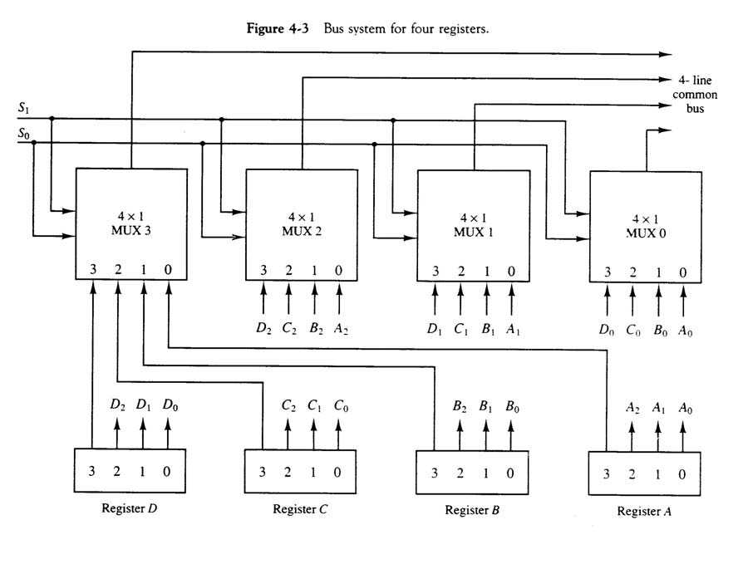

Slide 18
BUS AND BUS TRANSFER
Bus and Memory Transfers
Bus is a path(of a group of wires) over which information is transferred, from any of several sources to any of several destinations.
From a register to bus: BUS ← R
Register A
Register B
Register C
Register D
Bus lines
Register A
Register B
Register C
Register D
1
2
3
4
1
2
3
4
1
2
3
4
1
2
3
4
B
C
D
B
C
D
B
C
D
B
C
D
1
1
1
2
2
2
3
3
3
4
4
4
0
4 x1
0
4 x1
0
4 x1
0
4 x1
MUX
MUX
MUX
MUX
x
select
y
4-line bus

Slide 19
How to design
In general, a bus system will multiplex k registers of n bits each to produce an n-line common bus
• This requires n multiplexers – one for each bit
• The size of each multiplexer must be k x 1
• The number of select lines required is log k
Foe example, a commnon bus of 8 registers of 16 bits each requires 16 mux, one for each line in the bus. Mux of 8 data input and three selection lines.

Slide 20
Example
A digital computer has a common bus system for 16 registers of 32 bits each. The bus is constructed with mux
How many select inputs are there in each mux?
What size of mux are needed?
How many mux are there in bus?

Slide 21
BUS TRANSFER IN RTL
Bus and Memory Transfers
Depending on whether the bus is to be mentioned explicitly or not, register transfer can be indicated as either
or
In the former case the bus is implicit, but in the latter, it is explicitly indicated
R2 ← R1
BUS ← R1, R2 ← BUS

Slide 22
MEMORY (RAM)
Bus and Memory Transfers
Memory (RAM) can be thought as a sequential circuits containing some number of registers
These registers hold the words of memory
Each of the r registers is indicated by an address
These addresses range from 0 to r-1
Each register (word) can hold n bits of data
Assume the RAM contains r = 2k words. It needs the following
n data input lines
n data output lines
k address lines
A Read control line
A Write control line
data input lines
n
address lines
k
RAM
unit
Read
Write
n
data output lines

Slide 23
MEMORY TRANSFER
Bus and Memory Transfers
Collectively, the memory is viewed at the register level as a device, M.
Since it contains multiple locations, we must specify which address in memory we will be using
This is done by indexing memory references
Memory is usually accessed in computer systems by putting the desired address in a special register, the Memory Address Register (MAR, or AR)
When memory is accessed, the contents of the MAR get sent to the memory unit’s address lines
M
Memory
unit
Read
AR
Write
Data out
Data in

Slide 24
MEMORY READ
Bus and Memory Transfers
To read a value from a location in memory and load it into a register, the register transfer language notation looks like this:
This causes the following to occur
The contents of the MAR get sent to the memory address lines
A Read (= 1) gets sent to the memory unit
The contents of the specified address are put on the memory’s output data lines
These get sent over the bus to be loaded into register R1
R1 ← M[MAR]

Slide 25
MEMORY WRITE
Bus and Memory Transfers
To write a value from a register to a location in memory looks like this in register transfer language:
This causes the following to occur
The contents of the MAR get sent to the memory address lines
A Write (= 1) gets sent to the memory unit
The values in register R1 get sent over the bus to the data input lines of the memory
The values get loaded into the specified address in the memory
M[MAR] ← R1

Slide 26
SUMMARY OF R. TRANSFER MICROOPERATIONS
Bus and Memory Transfers
A ← B Transfer content of reg. B into reg. A
AR ← DR(AD) Transfer content of AD portion of reg. DR into reg. AR
A ← constant Transfer a binary constant into reg. A
ABUS ← R1, Transfer content of R1 into bus A and, at the same time,
R2 ← ABUS transfer content of bus A into R2
AR Address register
DR Data register
M[R] Memory word specified by reg. R
M Equivalent to M[AR]
DR ← M Memory read operation: transfers content of
memory word specified by AR into DR
M ← DR Memory write operation: transfers content of
DR into memory word specified by AR

Slide 27
MICROOPERATIONS
Arithmetic Microoperations
Computer system microoperations are of four types:
- Register transfer microoperations
- Arithmetic microoperations
- Logic microoperations
- Shift microoperations

Slide 28
ARITHMETIC MICROOPERATIONS
Arithmetic Microoperations
The basic arithmetic microoperations are
Addition
Subtraction
Increment
Decrement
The additional arithmetic microoperations are
Add with carry
Subtract with borrow
Transfer/Load
etc. …
Summary of Typical Arithmetic Micro-Operations
R3 ← R1 + R2 Contents of R1 plus R2 transferred to R3
R3 ← R1 - R2 Contents of R1 minus R2 transferred to R3
R2 ← R2’ Complement the contents of R2
R2 ← R2’+ 1 2's complement the contents of R2 (negate)
R3 ← R1 + R2’+ 1 subtraction
R1 ← R1 + 1 Increment
R1 ← R1 - 1 Decrement

Slide 29
BINARY ADDER / SUBTRACTOR / INCREMENTER
Arithmetic Microoperations
Binary Adder
Binary Adder-Subtractor
Binary Incrementer

Slide 30
4 bit binary adder-subtractor

Slide 31
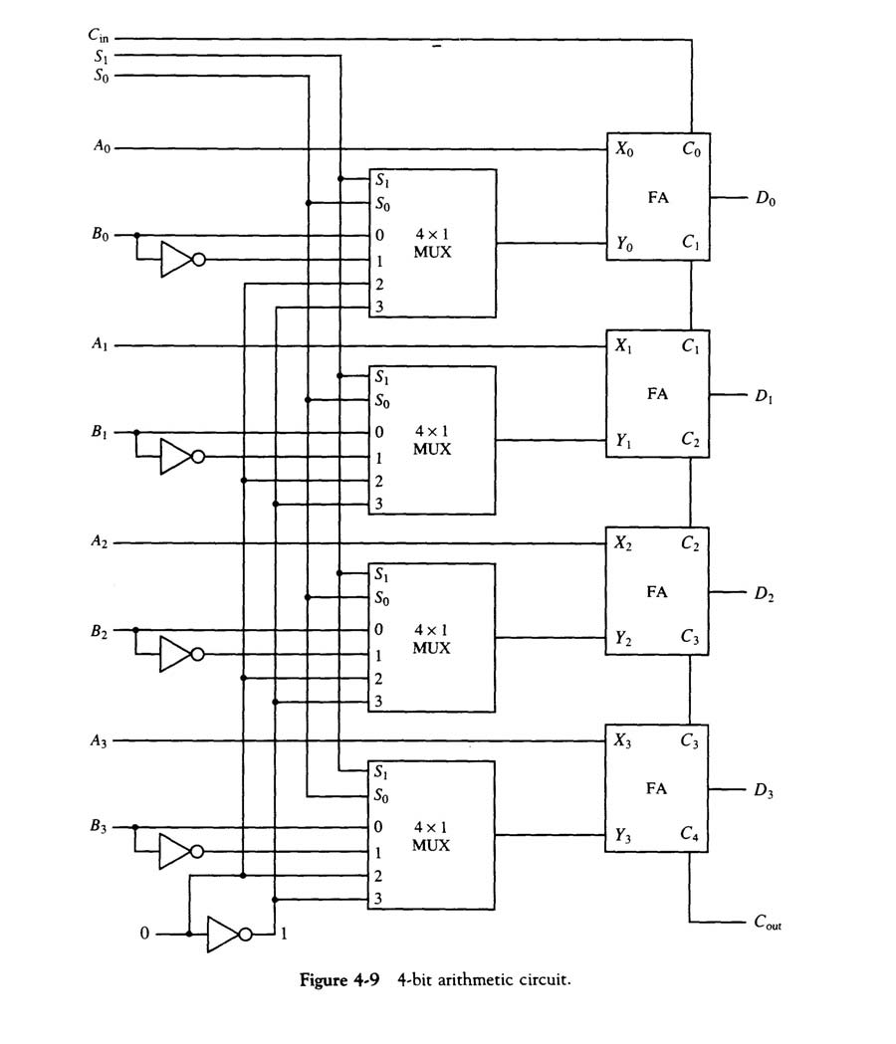

Slide 32
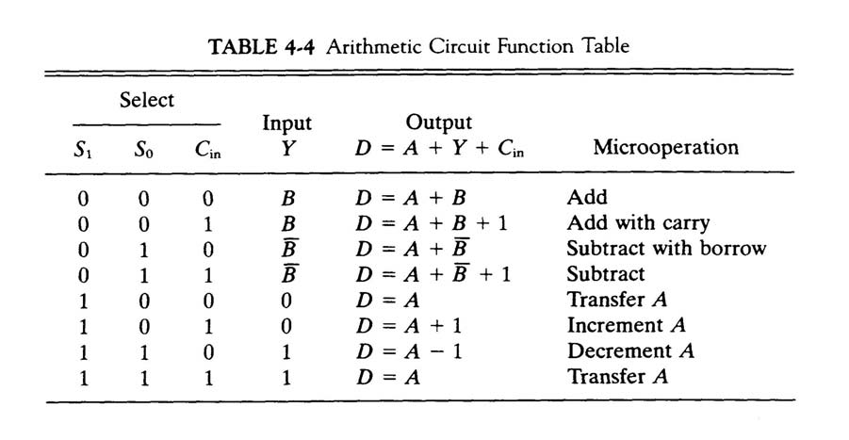
Arithmetic Circuits Functions

Slide 33
ARITHMETIC CIRCUIT
Arithmetic Microoperations
Cin
S1
S0
A0
X0
C0
S1
FA
D0
B0
S0
4x1
Y0
C1
0
1
MUX
2
3
A1
X1
C1
S1
FA
D1
B1
S0
4x1
Y1
C2
0
1
MUX
2
3
A2
X2
C2
S1
FA
D2
B2
S0
4x1
Y2
C3
0
1
MUX
2
3
A3
X3
C3
S1
FA
D3
B3
S0
4x1
Y3
C4
0
1
MUX
2
Cout
0
1
3
S1 S0 Cin Y Output Microoperation
0 0 0 B D = A + B Add
0 0 1 B D = A + B + 1 Add with carry
0 1 0 B’ D = A + B’ Subtract with borrow
0 1 1 B’ D = A + B’+ 1 Subtract
1 0 0 0 D = A Transfer A
1 0 1 0 D = A + 1 Increment A
1 1 0 1 D = A - 1 Decrement A
1 1 1 1 D = A Transfer A

Slide 34
LOGIC MICROOPERATIONS
Logic Microoperations
Specify binary operations on the strings of bits in registers
Logic microoperations are bit-wise operations, i.e., they work on the individual bits of data
useful for bit manipulations on binary data
useful for making logical decisions based on the bit value
There are, in principle, 16 different logic functions that can be defined over two binary input variables
However, most systems only implement four of these
AND (∧), OR (∨), XOR (⊕), Complement/NOT
The others can be created from combination of these
A B F₀ F₁ F₂ … F₁₃ F₁₄ F₁₅
0 0 0 0 0 … 1 1 1
0 1 0 0 0 … 1 1 1
1 0 0 0 1 … 0 1 1
1 1 0 1 0 … 1 0 1

Slide 35
LIST OF LOGIC MICROOPERATIONS
Logic Microoperations
List of Logic Microoperations
- 16 different logic operations with 2 binary vars.
- n binary vars → functions
2
2
n
Truth tables for 16 functions of 2 variables and the
corresponding 16 logic micro-operations
x 0 0 1 1
y 0 1 0 1
Boolean
Function
Micro-
Operations
Name
0 0 0 0 F0 = 0 F ← 0 Clear
0 0 0 1 F1 = xy F ← A ∧ B AND
0 0 1 0 F2 = xy' F ← A ∧ B’
0 0 1 1 F3 = x F ← A Transfer A
0 1 0 0 F4 = x'y F ← A’∧ B
0 1 0 1 F5 = y F ← B Transfer B
0 1 1 0 F6 = x ⊕ y F ← A ⊕ B Exclusive-OR
0 1 1 1 F7 = x + y F ← A ∨ B OR
1 0 0 0 F8 = (x + y)' F ← (A ∨ B)’ NOR
1 0 0 1 F9 = (x ⊕ y)' F ← (A ⊕ B)’ Exclusive-NOR
1 0 1 0 F10 = y' F ← B’ Complement B
1 0 1 1 F11 = x + y' F ← A ∨ B
1 1 0 0 F12 = x' F ← A’ Complement A
1 1 0 1 F13 = x' + y F ← A’∨ B
1 1 1 0 F14 = (xy)' F ← (A ∧ B)’ NAND
1 1 1 1 F15 = 1 F ← all 1's Set to all 1's

Slide 36
HARDWARE IMPLEMENTATION OF LOGIC MICROOPERATIONS
Logic Microoperations
A
i
0
B
i
1
4 X 1
F
MUX
i
2
3
Select
S
1
S
0
Function table
S₁ S₀
Output
μ-operation
0 0 F = A ∧ B AND
0 1 F = A ∨ B OR
1 0 F = A ⊕ B XOR
1 1 F = A’ Complement

Slide 37
APPLICATIONS OF LOGIC MICROOPERATIONS
Logic Microoperations
Logic microoperations can be used to manipulate individual bits or a portions of a word in a register
Consider the data in a register A. In another register, B, is bit data that will be used to modify the contents of A
Selective-set A ← A + B
Selective-complement A ← A ⊕ B
Selective-clear A ← A • B’
Mask (Delete) A ← A • B
Clear A ← A ⊕ B
Insert A ← (A • B) + C
Compare A ← A ⊕ B
. . .

Slide 38
SELECTIVE SET
Logic Microoperations
In a selective set operation, the bit pattern in B is used to set certain bits in A
1 1 0 0 A_{t}
1 0 1 0 B
1 1 1 0 A_{t+1} (A ← A + B)
If a bit in B is set to 1, that same position in A gets set to 1, otherwise that bit in A keeps its previous value

Slide 39
SELECTIVE COMPLEMENT
Logic Microoperations
In a selective complement operation, the bit pattern in B is used to complement certain bits in A
1 1 0 0 A_{t}
1 0 1 0 B
0 1 1 0 A_{t+1} (A ← A ⊕ B)
If a bit in B is set to 1, that same position in A gets complemented from its original value, otherwise it is unchanged

Slide 40
SELECTIVE CLEAR
Logic Microoperations
In a selective clear operation, the bit pattern in B is used to clear certain bits in A
1 1 0 0 A_{t}
1 0 1 0 B
0 1 0 0 A_{t+1} (A ← A ⋅ B’)
If a bit in B is set to 1, that same position in A gets set to 0, otherwise it is unchanged

Slide 41
MASK OPERATION
Logic Microoperations
In a mask operation, the bit pattern in B is used to clear certain bits in A
1 1 0 0 A_{t}
1 0 1 0 B
1 0 0 0 A_{t+1} (A ← A ⋅ B)
If a bit in B is set to 0, that same position in A gets set to 0, otherwise it is unchanged

Slide 42
CLEAR OPERATION
Logic Microoperations
In a clear operation, if the bits in the same position in A and B are the same, they are cleared in A, otherwise they are set in A
1 1 0 0 A_{t}
1 0 1 0 B
0 1 1 0 A_{t+1} (A ← A ⊕ B)

Slide 43
INSERT OPERATION
Logic Microoperations
An insert operation is used to introduce a specific bit pattern into A register, leaving the other bit positions unchanged
This is done as
A mask operation to clear the desired bit positions, followed by
An OR operation to introduce the new bits into the desired positions
Example
Suppose you wanted to introduce 1010 into the low order four bits of A: 1101 1000 1011 0001 A (Original) 1101 1000 1011 1010 A (Desired)
1101 1000 1011 0001 A (Original)
1111 1111 1111 0000 Mask
1101 1000 1011 0000 A (Intermediate)
0000 0000 0000 1010 Added bits
1101 1000 1011 1010 A (Desired)

Slide 44
LOGICAL SHIFT
Shift Microoperations
In a logical shift the serial input to the shift is a 0.
A right logical shift operation:
A left logical shift operation:
In a Register Transfer Language, the following notation is used
shl for a logical shift left
shr for a logical shift right
Examples:
R2 ← shr R2
R3 ← shl R3
0
0

Slide 45
CIRCULAR SHIFT
Shift Microoperations
In a circular shift the serial input is the bit that is shifted out of the other end of the register.
A right circular shift operation:
A left circular shift operation:
In a RTL, the following notation is used
cil for a circular shift left
cir for a circular shift right
Examples:
R2 ← cir R2
R3 ← cil R3

Slide 46
Logical versus Arithmetic Shift
A logical shift fills the newly created bit position with zero:
An arithmetic shift fills the newly created bit position with a copy of the number’s sign bit:

Slide 47
ARITHMETIC SHIFT
Shift Microoperations
An left arithmetic shift operation must be checked for the overflow
0
sign
bit
Before the shift, if the leftmost two
bits differ, the shift will result in an
overflow
V
In a RTL, the following notation is used
ashl for an arithmetic shift left
ashr for an arithmetic shift right
Examples:
R2 ← ashr R2
R3 ← ashl R3

Slide 48
HARDWARE IMPLEMENTATION OF SHIFT MICROOPERATIONS
Shift Microoperations
Serial
input (I_{R})
Select
0 for shift right (down)
1 for shift left (up)
S
H0
0
MUX
1
A0
A1
S
H1
0
MUX
A2
1
A3
S
0
MUX
H2
1
S
H3
0
MUX
1
Serial
input (I_{L})

